Slide 1
PROVINCIAL EDUCATION SUMMIT
Overview PERFORMANCE of
limpopo DEPARTMENT OF education
ACTING HoD: Limpopo Department of Education
Ms NB Mutheiwana
09 MAY 2016
MEROPA CASINO

Slide 2
PRESENTATION OUTLINE
INTRODUCTION
MANDATE
OBJECTIVES
STRATEGIC DIRECTION
SITUATIONAL ANALYSIS OF LDOE PERFORMANCE
EDUCATION SECTOR VALUE CHAIN
INFRASTRUCTURE PROVISION
CONCLUSION
2

Slide 3
Introduction
The Government of South Africa has declared Education as a key priority, taking into consideration the fact that it is a pre-condition for a developmental state.
Therefore equipping our people with knowledge and skills is a prerequisite for development and will allow them to fulfill a productive role in society.
Quality education depends not only on educators, but also on LTSM, on libraries and science laboratories, on conducive classrooms with good furniture, on clean toilets, on water, on scholar transport, on good nutrition for learners, sports field and on protection from sexual violence against learners as well as on good administration and support.

Slide 4
Mandate
The Department derives its mandate from:
The Constitution of the Republic of South Africa
National Development Plan
Limpopo Development Plan
Medium Term Strategic Framework
Sector Plan ‘Action Plan to 2019, Towards the Realization of Schooling 2030”
Delivery Agreement between the MEC and the Minister for Basic Education
State of the Nation Address
State of the Province Address

Slide 5
Objectives
Improve Early Childhood Development
Improve the quality of teaching and learning
Provision of Learner Teacher Support Materials (LTSM)
Strengthened School Management and support
Provision of school infrastructure
Improve access to quality Education

Slide 6
STRATEGIC DIRECTION
(ALIGNED NDP, MTSF AND NON-NEGOTIABLES)

Slide 7
STRATEGIC DIRECTION
ALIGNED NDP, MTSF AND NON-NEGOTIABLES
NDP | MTSF (Strategic Direction) | NON-NEGOTIABLES
Improve the provision of adequate, quality infrastructure and Learning and Teaching Support Materials (LTSM). | MTSF Output 2: Improved quality of teaching and learning through provision of adequate, quality infrastructure and Learning materials | LTSM To provide core textbooks per learner, per subject and per grade The need to centralize procurement of LTSM
Minimum standards progressively attained Labs, computer, media centres School Safety ICT in education – mobile devices, broadband, connectivity | MTSF Output 2: Improved quality of teaching and learning through provision of adequate, quality infrastructure and Learning materials | INFRASTRUCTURE Reducing inappropriate school structures, by constructing new ones and maintaining existing ones pprioritizing the provision of basic services to schools (water, sanitation & electricity)

Slide 8
STRATEGIC DIRECTION
ALIGNED NDP, MTSF AND NON-NEGOTIABLES
NDP | MTSF ( Strategic Direction) | NON-NEGOTIABLES
Districts and institutional capacity Appointment of principals will be based on competency assessments Introduce performance contract for principals Introduce an education accountability chain, with lines of responsibility from state to classroom | MTSF Output 5: Strengthening accountability and improving management at the school, community and district level | DISTRICTS Improving districts operations (planning, monitoring and evaluation, curriculum oversight,) Improving schools capacity (curriculum monitoring, oversight roles of principals and SMTs) Appointment of competent principals
Teacher development should build teacher subject knowledge Addressing policy blockages that prevent the deployment of teachers A formalised graduate recruitment scheme for the public service Ensure that Funza Lushaka graduates are immediately absorbed into schools | MTSF Output 1: Improved quality of teaching and learning through development, supply and effective utilisation of teachers | TEACHERS PLACEMENT, DEPLOYMENT, AND DEVELOPMENT Teacher recruitment, deployment and utilisation Attracting young educators into the system Absorption of Funza Lushaka bursary holders

Slide 9
STRATEGIC DIRECTION
ALIGNED NDP, MTSF AND NON-NEGOTIABLES
NDP | MTSF (Strategic Direction) | NON-NEGOTIABLES
Rewarding teaching excellence Expose teachers to the use of technology in their own training and train them to use it in their teaching | MTSF Output 1: Improved quality of teaching and learning through development, supply and effective utilisation of teachers | ICT Access and resource materials available Providing teachers with ICT infrastructure
Utilisation of Learners home language in schools | MTSF Output 2: Improved quality of teaching and learning through provision of adequate, quality infrastructure and Learning materials | LIBRARY SERVICES Focus of reading and library resourcing and resourcing libraries in schools

Slide 10
STRATEGIC DIRECTION
NDP | MTSF( Strategic Direction) | NON-NEGOTIABLES
Ensure that Funza Lushaka graduates are immediately absorbed into schools Change the pay structure of teachers: Addressing policy blockages that prevent the deployment of teachers A formalised graduate recruitment scheme for the public service | MTSF Output 1: Improved quality of teaching and learning through development, supply and effective utilisation of teachers | RURAL FOCUS Rationalisation of non-viable schools, provision of scholar transport and hostel facilities; Training teachers on Multi-grade teaching; Resourcing small schools
Curriculum stability –Keeping curriculum changes to a minimum Inclusive education: Ensuring that all children with disabilities have access to quality education Language – Home language, and English earlier in Foundation Phase Universal access to two years of early childhood development | MTSF Output 3: Regular annual national assessments to track improvements in the quality of teaching and learning MTSF Output 4: Improved Grade R and planning for extension of ECD | CURRICULUM MST: Enrolments and performance History: Introduction of History IIAL: Piloting the introduction of African Languages ANA Testing: Improving assessments for improved teaching and learning

Slide 11
SITUATIONAL ANALYSIS OF LDoE PERFORMANCE

Slide 12
AUDIT OUTCOMES – INSTITUTIONAL PERFORMANCE
Province |  | Audit Outcome
 | 2014/15 | 2013/14 | 2012/13 | 2011/12 | 2010/11 | 2009/10 | 2008/09
Eastern Cape
Free State
Gauteng
KwaZulu-Natal
Limpopo
Mpumalanga
Northern Cape
North West
Western Cape
NOTES
Unqualified
Qualified
Disclaimer
Adverse

Slide 13
LEARNER ENROLMENT
SIZE AND SHAPE OF LDoE
Year | INDEPENDENT | PUBLIC
2009 | 43589 | 1,676,100
2010 | 45621 | 1,665,581
2011 | 48545 | 1,635,457
2012 | 51515 | 1,656,846
2013 | 53153 | 1,648,105
2014 | 56869 | 1,658,522
2015 | 58668 | 1,681,254
Provincially, there was a slight decrease in the public learner enrolment from 2009 to 2011. An increase in the public learner enrolment was observed from 2013. The provincial independent learner enrolment shows an increase since 2009.

Slide 14
LEARNER ENROLMENT
SIZE AND SHAPE OF LDoE
Year | Female | Male
2009 | 826513 | 849697
2010 | 820027 | 846105
2011 | 804093 | 831622
2012 | 814613 | 842233
2013 | 810293 | 837812
2014 | 816059 | 842463
2015 | 826693 | 854561
The numbers of male learners are significantly more than female learners since 2009.

Slide 15
SIZE AND SHAPE OF LDoE
PERCENTAGE OF FEMALE TEACHERS (%FT)
Year | % FT Primary Phase | % FT Sec Phase
2010 | 59.2 | 47.2
2011 | 64.4 | 51.4
2012 | 63.0 | 51.4
2013 | 61.2 | 48.1
2014 | 61.1 | 48.3
2015 | 61.0 | 48.8
The number of female teachers at a given level of education expressed as a percentage of the total number of teachers (male and female) at the same level in a given school year
Interpretation: Percentage of female teachers approaching 50% indicates gender parity in the composition of the teaching force. A value of greater than 50% reveals more opportunities and/or preference for women to participate in teaching activities at a specific level, grade or programme of education.

Slide 16
# Learners, educators and schools in public schools with indicators LER: the learner educator ratio is the average number of learners per educator in Limpopo LSR: the learner school ratio indicates the average number of learners per school in Limpopo ESR: the educator school ratio indicates the average number of educators per school
SIZE AND SHAPE OF LDoE
BASIC SCHOOL DATA ( LER,LSR AND ESR)
YEAR | ENROLMENT | EDUCATORS | SCHOOLS | LER | LSR | ESR
2010 | 1665581 | 56104 | 3958 | 29.7 | 421 | 14.2
2011 | 1635457 | 56726 | 3936 | 28.8 | 416 | 14.4
2012 | 1656846 | 55898 | 3933 | 29.6 | 421 | 14.2
2013 | 1648105 | 55307 | 3927 | 29.8 | 420 | 14.1
2014 | 1658522 | 55217 | 3914 | 30.0 | 424 | 14.1
2015 | 1681254 | 52982 | 3890 | 31.7 | 432 | 13.6

Slide 17
7 TO 15 YEAR OLD CHILDREN WITH DISABILITIES ATTENDING EDUCATIONAL INSTITUTIONS, 2005-2014
CURRICULUM IMPLEMENTATION
Province | 2005 | 2006 | 2007 | 2008 | 2009 | 2010 | 2011 | 2012 | 2013 | 2014
Limpopo | 69.5 | 85.1 | 74.6 | 63.2 | 88.2 | 93.1 | 95.5 | 87.7 | 86.7 | 92.4
National | 77.8 | 78.6 | 74.6 | 77.0 | 89.7 | 93.2 | 92.1 | 92.4 | 92.5 | 93.4
Source: Statistics South Africa, General Household Survey (GHS), DBE own calculations
17

Slide 18
PERCENTAGE OF LEARNERS BENEFITING FROM THE SCHOOL FEEDING SCHEME
SOCIAL COHESION
Province | 2010 | 2011 | 2012 | 2013 | 2014
Limpopo | 84.7 | 94.4 | 94.7 | 93.5 | 94.3
National | 69.9 | 76.2 | 77.4 | 78.7 | 79.7
Source: Statistics South Africa, General Household Survey (GHS), DBE own calculations

Slide 19
NUMBER OF ORDINARY SCHOOLS
SIZE AND SHAPE OF LDoE
Year | INDEPENDENT | PUBLIC
2009 | 141 | 3969
2010 | 142 | 3958
2011 | 140 | 3936
2012 | 147 | 3933
2013 | 145 | 3927
2014 | 147 | 3914
2015 | 151 | 3890
2016 | 156 | 3876
The number of public ordinary schools has decreased since 2009, with the merging of schools as a possible reason. The number of independent schools have increased since 2009

Slide 20
LEARNER ENROLMENT 2009 - 2015
SIZE AND SHAPE OF LDoE

Slide 21
NUMBER OF SCHOOLS IN LIMPOPO 2009 - 2016
SIZE AND SHAPE OF LDoE
The figures reflect the decrease of public schools and increase of independent schools

Slide 22
LEARNER PREGNANCY
SIZE AND SHAPE OF LDoE
Year | PUBLIC
2009 | 10757
2010 | 10241
2011 | 2291
2012 | 1488
2013 | 1013
2014 | 633
2015 | 886
This figure reflects the number of female learners that fell pregnant during the previous academic year. There was a significant decrease in female pregnancies since 2009.

Slide 23
SIZE AND SHAPE OF LDoE
PROMOTION RATE BY GRADE (PR)
Proportion of pupils from a cohort enrolled in a given grade at a given school year who study in the next grade in the following school year.
Ideally, the rate should approach 100%; a high rate reflects high internal efficiency of the educational system. When compared across grades, the patterns can indicate specific grades for which there is low promotion.

Slide 24
The dropout rate indicates the proportion of pupils from a cohort enrolled in a given grade at a given school year who are no longer enrolled in the following school year. Ideally, the rate should approach 0%; a high dropout rate reveals problems in the internal efficiency of the educational system. By comparing rates across grades, it is possible to identify those which require greater policy emphasis.
SIZE AND SHAPE OF LDoE
DROPOUT RATE BY GRADE (DR)

Slide 25
NO FEE LEARNERS AND NO FEE SCHOOLS IN 2015
BENCHMARKING ( COMPARATIVE VIEW)
PROV | No. of No Fee Learners | % No Fee Learners | No. of No Fee Schools | % No Fee Schools
EC | 1,725,313 | 91.3% | 5,320 | 95.8%
FS | 543,288 | 82.8% | 1,147 | 87.8%
GP | 1,231,673 | 63.3% | 1,376 | 66.5%
KZN | 1,965,951 | 69.4% | 5,005 | 84.6%
LP | 1,603,765 | 96.3% | 3,838 | 97.7%
MP | 884,993 | 85.6% | 1,631 | 92.6%
NC | 200,287 | 70.3% | 415 | 75.3%
NW | 701,971 | 89.5% | 1,349 | 89.0%
WC | 599,874 | 58.4% | 884 | 60.6%
SA | 9,457,115 | 78.6% | 20,965 | 87.14%

Slide 26
PERCENTAGE OF LEARNERS WHO INDICATED THEY HAD EXPERIENCED LACK OF BOOKS AT SCHOOL BY PROVINCE, 2002 – 2014
BENCHMARKING ( COMPARATIVE VIEW)
Source: Statistics South Africa, General Household Survey (GHS), DBE own calculations
23

Slide 27
ACHIEVEMENT LEVELS OF GRADE 3 LEARNERS IN MATHEMATICS
EXAMINATION AND ASSESMENT

Slide 30
BENCHMARKING ( COMPARATIVE VIEW)
PROVINCIAL NSC PERFORMANCE
Province | NSC 2014 | NSC 2015
EC | 65.4 | 56.8
FS | 82.8 | 81.6
GP | 84.7 | 84.2
KZN | 69.7 | 60.7
LP | 72.9 | 65.9
MP | 79.0 | 78.6
NW | 84.6 | 81.5
NC | 76.4 | 69.4
WC | 82.2 | 84.7
National | 75.8 | 70.7

Slide 31
PROVINCIAL NSC PERFORMANCE…
BENCHMARKING ( COMPARATIVE VIEW)

Slide 32
Analysis of the 2015 Grade 12 results
District | 2014 | Number wrote in 2015 (FT) | 2015 | % Decline
Sekhukhune | 63.9% | 21 531 | 55.0% | 8.9%
Waterberg | 70.5% | 9 518 | 58.1% | 12.4%
Capricorn | 71.6% | 24 839 | 66.7% | 4.8%
Mopani | 74.3% | 19 152 | 68.9% | 5.4%
Vhembe | 81.1% | 26 535 | 74.7% | 6.5%
Province | 72.9% | 101 575 | 65.9% | 7.0%

Slide 33
Performance in selected subjects
Subject | Wrote | Pass L2+ | L4 | L5 | L6 | L7 | 2015 Pass % L2+ | 2014 Pass % L2+ | Variance
Accounting | 22 945 | 12 679 | 1 719 | 907 | 505 | 447 | 55.3 | 69.7 | -14.5
Agricultural Sciences | 32 106 | 24 454 | 3 823 | 1 353 | 352 | 52 | 76.2 | 81.6 | -5.4
Business Studies | 28 300 | 17 765 | 2 665 | 1 151 | 440 | 133 | 62.8 | 67.1 | -4.3
Economics | 30 742 | 21 036 | 3 590 | 1 517 | 580 | 211 | 68.4 | 65.1 | 3.3
Geography | 55 617 | 42 776 | 8 521 | 4 524 | 1 849 | 719 | 76.9 | 81.7 | -4.8
History | 18 478 | 14 301 | 3 140 | 1 176 | 266 | 33 | 77.4 | 74.9 | 2.5
Life Sciences | 62 531 | 42 817 | 7 096 | 4 111 | 2 061 | 927 | 68.5 | 71.7 | -3.2
Mathematics | 40 673 | 21 188 | 3 522 | 2 120 | 1 317 | 963 | 52.1 | 56.9 | -4.8
Mathematical Literacy | 61 282 | 41 807 | 5 706 | 2 245 | 819 | 245 | 68.2 | 83.2 | -14.9
Physical Sciences | 33 680 | 20 063 | 3 273 | 1 904 | 989 | 629 | 59.6 | 66.7 | -7.1

Slide 34
Performance of Progressed Learners
Total number of Progressed | Number wrote | Number passed | Pass %
13 229 | 13 022 | 3 492 | 26.8%

Slide 35
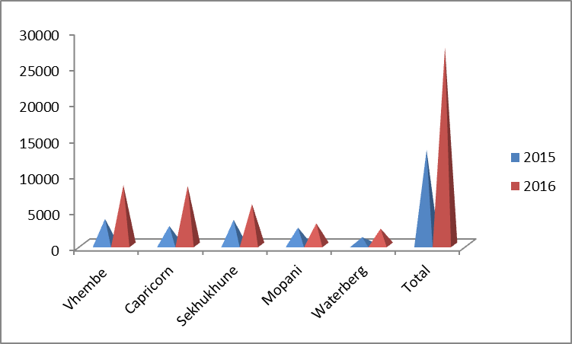
2016 vs 2015 Progressed Learners

Slide 36
Circuit Performance (Summary)
District | Total number of circuits | Performance in 2014 | Under-performance in 2014 | Performance in 2015 | Under-performance in 2015
Capricorn | 32 | 29 | 3 | 23 | 9
Sekhukhune | 33 | 20 | 13 | 11 | 22
Mopani | 24 | 23 | 1 | 16 | 8
Vhembe | 27 | 27 | 0 | 26 | 1
Waterberg | 18 | 14 | 4 | 8 | 10
Province | 134 | 113 | 21 | 84 | 50

Slide 37
Number of underperforming public schools
District | 2014/11 | 2015/11 | Variance
Waterberg | 50 | 85 | 35
Capricorn | 97 | 144 | 47
Vhembe | 23 | 62 | 39
Mopani | 54 | 77 | 23
Sekhukhune | 147 | 195 | 48
PROVINCE | 371 | 563 | 192

Slide 38
Small and Non-viable schools
District | Number Of Schools To Be Merged | No. Of Merged Schools | No. Learner Affected | No. Of Educators Affected | Scholar Transport required | Mobile Classrooms required
Capricorn | 49 | 25 | 5388 | 184 | 09 | 46
Mopani | 49 | 08 | 1901 | 59 | Nil | Nil
Sekhukhune | 42 | 06 | 1531 | 43 | 07 | 35
Vhembe | 109 | 40 | 4678 | 159 | 15 | 66
Waterberg | 91 | 21 | 3314 | 115 | 37 | 12
TOTAL | 301 | 100 | 16812 | 560 | 68 | 159

Slide 39
EDUCATION SECTOR VALUE CHAIN

Slide 40
EDUCATION SECTOR VALUE CHAIN
Access
to quality
education
National education system
National level
Provincial education system
Provincial level
Education district system
District level
School education system
School Level
Teaching and learning
Resource utilisation
Policy implementation
Short term planning
Resource management
Needs assessment
Systems implementations
Systems utilisation
Policy implementation
Develops policies
Conduct long-term planning
Allocate resources
Monitor and evaluate implementation
Systemic planning
Policy dissemination and implementation
Medium-term planning
Resource distribution
Managing systems implementation

Slide 41
Education and Training Value Chain
Quality of Life
Technical & Vocational Education
Public TVET colleges
Private colleges
University Education
Comprehensive universities
Universities of technology
Community learning centre
Skills development centres
Home-based care centres
Private universities
Basic Education
Post school education & Training
Workplace Skills Development (WSD)
Decent & sustainable jobs
Economic Sectors
Public
Informal
Private
School leadership
Teachers
infrastructure
Learner s
WSD
Learnerships
Bursaries
Skills Programme
Internship

Slide 42




DISTRICT COORDINATION
Ideal end-state
Associated initiatives
Clear mandate and effective structure
Policy basis for the role and structure of districts and circuits, to ensure effective school coverage
1
Publish and embed flexible norms and standards into regulations
Right people in the right roles
Districts and circuits have enough people in the right roles, who know their responsibilities, and have the capabilities and skills to fulfil them
2
Clarify roles, responsibilities and KPIs; formalize recruitment criteria
3
Fill critical vacancies
4
Build key competencies through capability building
Enough tools and resources to do the job
Districts and circuits are provided with the necessary tools of trade to fulfil their responsibilities, incl. ICT, vehicles, etc.
5
Define & monitor provisioning of minimum resource package
Standard operations for supporting schools and managing districts
District and circuit officials have a standard for how to support schools most effectively, through a codified but flexible definition of essential routines
6
Clarify and embed termly routines for district officials
7
Enhance internal management practices of district offices
8
Introduce data collection and monitoring tools to simplify district management & interactions

Slide 43

School Leadership
“Lack of leadership is the main contributor to underperformance and dysfunctionality in schools”.
Principal
LTSM
infrastructure
Teacher training
Learner nutrition and transport
Education Information Management
School management
Early Childhood Development
Inclusive education
Annual management processes
Daily record keeping
Managing Educational Programmes
Learner Transport
Inclusive education
Managing resources
School Infrastructure
Managing SMT and coordinating SGB
Staff management
Information system
Annual plan & report
School nutrition
Teacher development
Safety & discipline
School facilities
Changes in the new system of governance in schools have resulted in school principals to be unprepared for the new role

Slide 44
INFRASTRUCTURE PROVISIONING

Slide 45
INFRASTRUCTURE PROVISIONING
Basic infrastructure and services have been supplied to a number of schools as follows:
Schools are supplied with sanitation facilities
Classrooms were built in public ordinary schools
Specialist rooms were built public ordinary schools.

Slide 46
Outstanding Programmes to be implemented
Outstanding PMU projects
The Department is experiencing a challenge of incomplete Projects since 2012/13
Norms and Standards
CSIR Condition Assessment and identification of needs
Number of Pit Latrines still in the Province
Reporting and accuracy of information
Programme management and Reporting Tool
The Department has re-prioritised quick wins projects including storm damaged schools
Relocation of Mobile classrooms

Slide 47
Water and Sanitation
Implementation of Water and Sanitation
The Department has entered into Service Level Agreement with MVULA Trust and IDT to build toilets and boreholes to schools.

Slide 48
Storm Damaged Schools

Slide 49
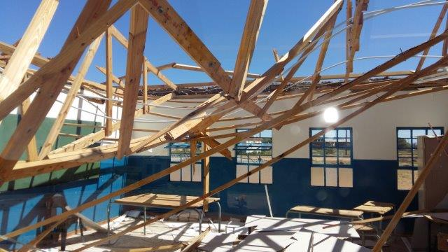

Slide 50
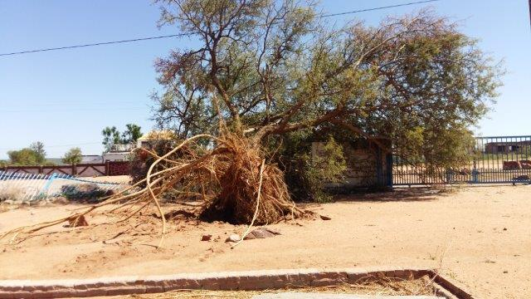

Slide 51
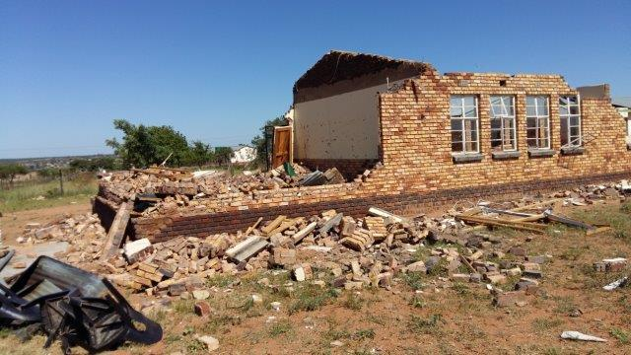

Slide 52
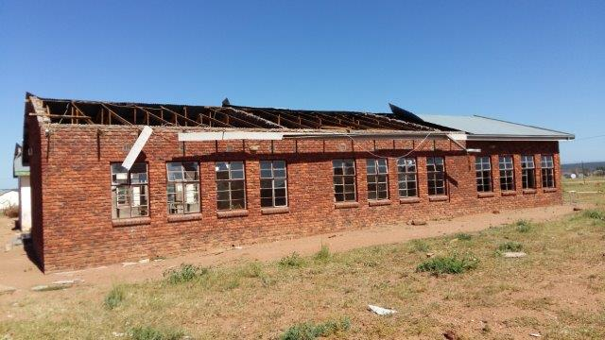

Slide 53
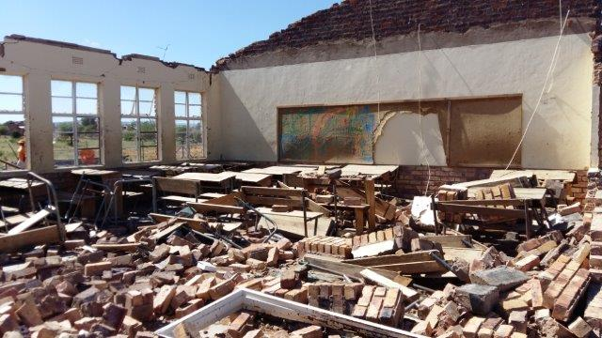

Slide 54
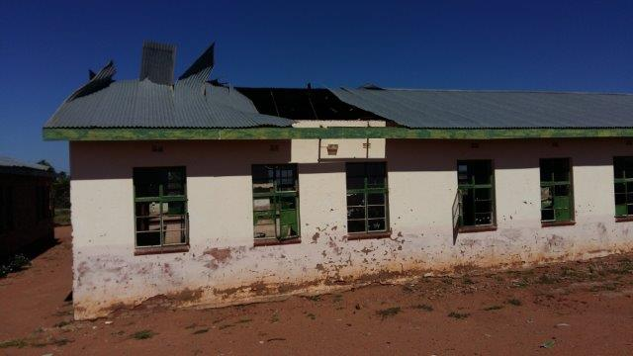

Slide 55
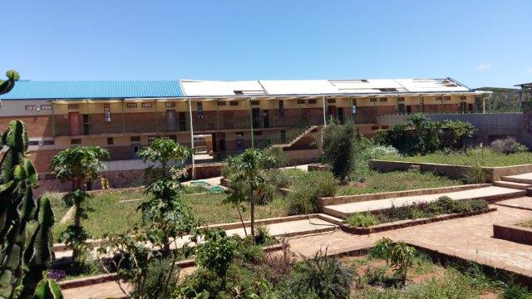

Slide 56
SCHOOLS AFFECTED BY THE RECENT RIOTS

Slide 57
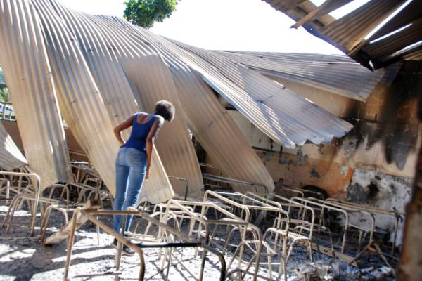

Slide 58
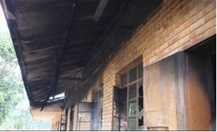
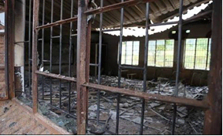
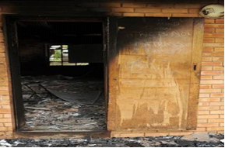
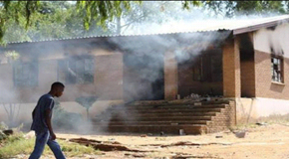

Slide 59
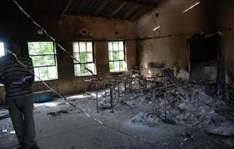

Slide 60
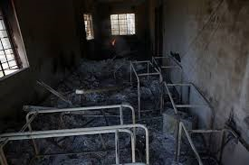

Slide 61
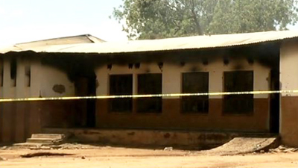

Slide 62
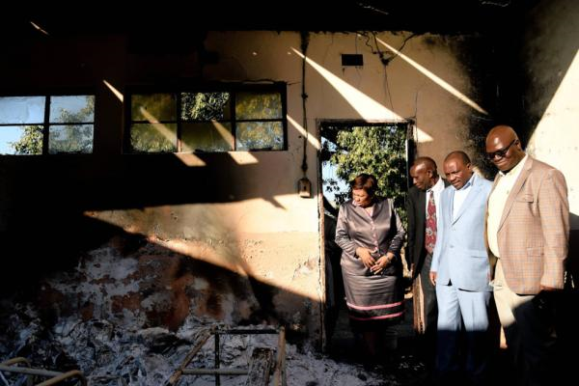

Slide 63
CONCLUSION
We wish to conclude by affirming that the National Development Plan, especially on education system, planning and provisioning, is aligned with the Department of Basic Education’s Action Plan to 2014/2019, Towards the realisation of Schooling 2025/2030 in both its diagnosis and proposed solutions. These plans are therefore complementary and not contradictory.
improving literacy, numeracy/mathematics and science outcomes;
increasing the number of learners eligible to study maths and science-based degrees at higher education institutions;
improving performance in the national and international comparative studies; and
ensuring that access to education is not compromised; but improve the internal efficiency of the system (quality input, retention and output ratios, especially those of the girl child).

Slide 64

ANSWERS EXPECTED FROM THE SUMMIT
What strategies and programmes do we have to put in place to improve learner performance from foundation phase up to Grade 12;
Who are the role players;
What is their role;
What are the resources requirements;
Where will such resources come from;
What support, monitoring and evaluation mechanism will be put in place;

Slide 65
NDI A LIVHUWA

